Slide 1

News Bytes
JAN-FEB 2015

Slide 2

GHOST Vulnerability
Vulnerability in glibc function gethostbyname()
Affected almost all linux distributions.
CVE-2015-0235

Slide 3
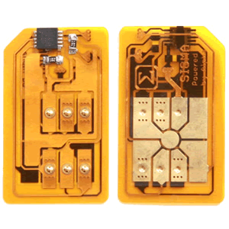
Gemalto Hack
Supposedly a joint operation of NSA and GCHQ.
Possible stolen SIM Keys.

Slide 4

Superfish
Pre-installed adware on Lenovo devices.
Intercepts SSL traffic to push Ads.

Slide 5

Anthem Hacked
Around 80 million records stolen.
Notes:
US 2nd largest health insurer.

Slide 6
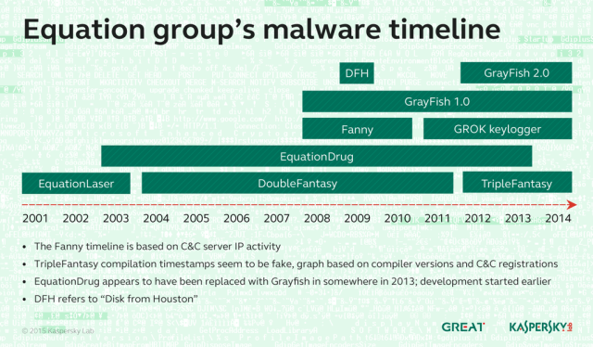
Equation Group
Malwares capable of infecting HDD firmware.
Indicative relations to Stuxnet/Flame (NSA??)
Notes:
NSA denies any public comment.

Slide 7

Google discontinues Pwnium
Launches $“infinity” million bounty program.

Slide 8

US offers $3M bounty
FBI offers $3M bounty for information leading arrest of Zeus Gameover Botnet mastermind.
Notes:
Evgeniy Mikhailovich Bogachev

Slide 9

ZeroDay in fancybox plugin
FancyBox wordpress vulnerable to SQL injection.
Allows iframe-injection in half a million sites around the world.

Slide 10

Upcoming Conferences
RootedCON
Madrid, Spain
March 5th-7th
Atlantic Security Conference
Hailfax, NS, Canada
March 16th-17th
Troopers
Heidelburg, Germany
March 16th-20th
Palo Alto Ignite
Las Vegas
March 30th – April 1st

Slide 11

Upcoming CFP
DEF CON 24
CFP End: May 10, 2015
Conference: August 6th-9th, Las Vegas
FUDCon 2015
CFP End: March 9th
Conference: June 26th-28th, Pune

Slide 12

The END

